Slide 1
Taboo Game-like: Project
Intelligent Interfaces
Wissam Nasser, Wouter Parys, Charlotte Waltregny

Slide 2
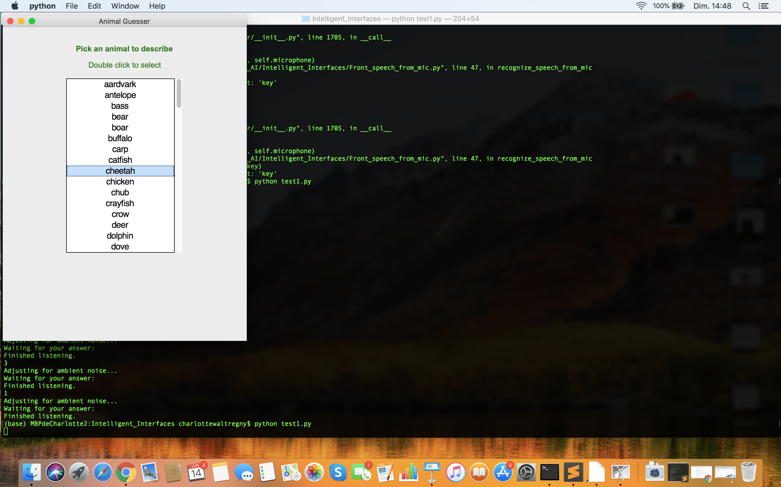
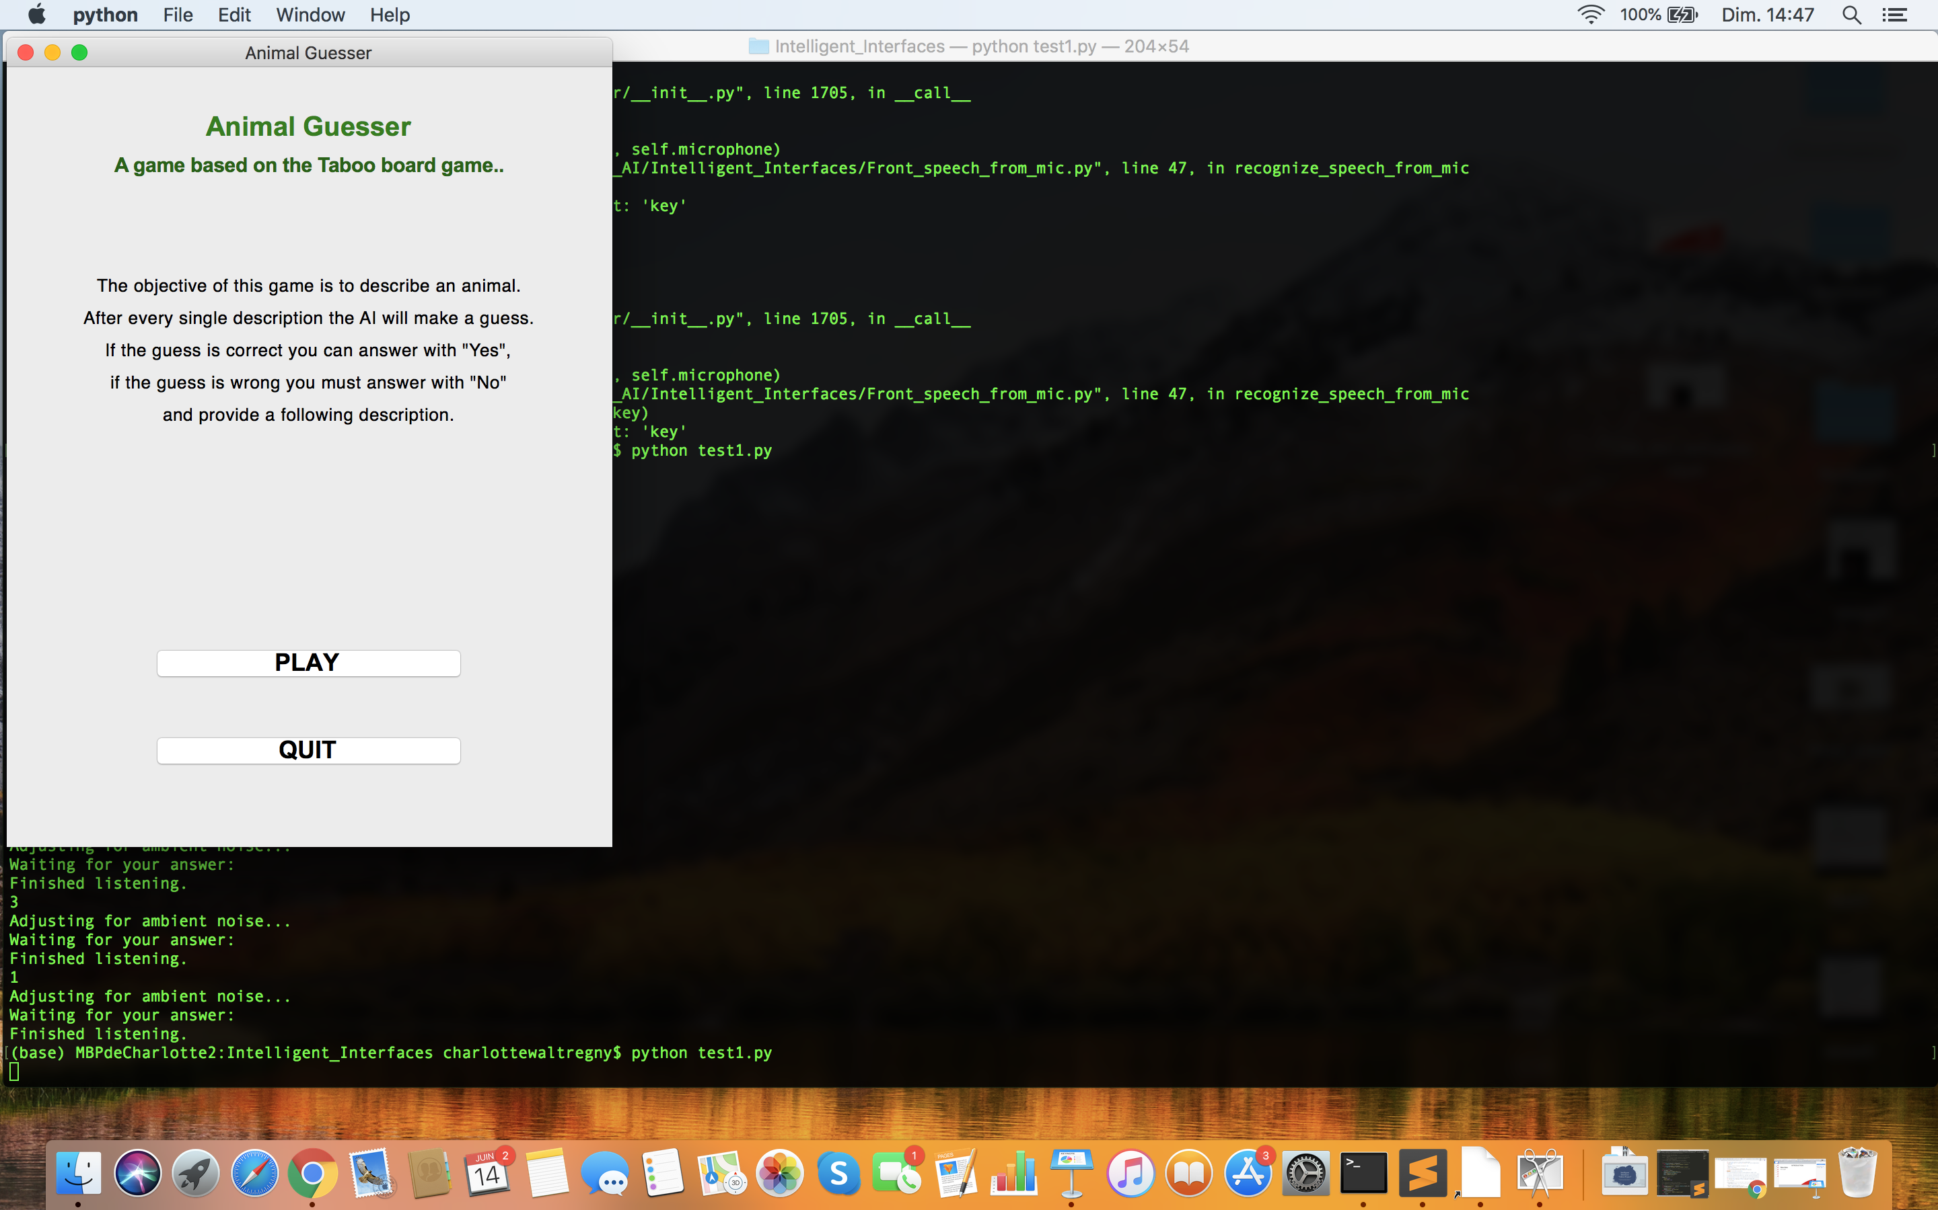
INTRODUCTION
Taboo Game-like
How to play?
1
2
User selects animal
in the dropdown list
retrieved from ElasticSearch
database
User presses PLAY button

Slide 3
DATABASE
ElasticSearch

Slide 4
DATABASE
ElasticSearch

Slide 5
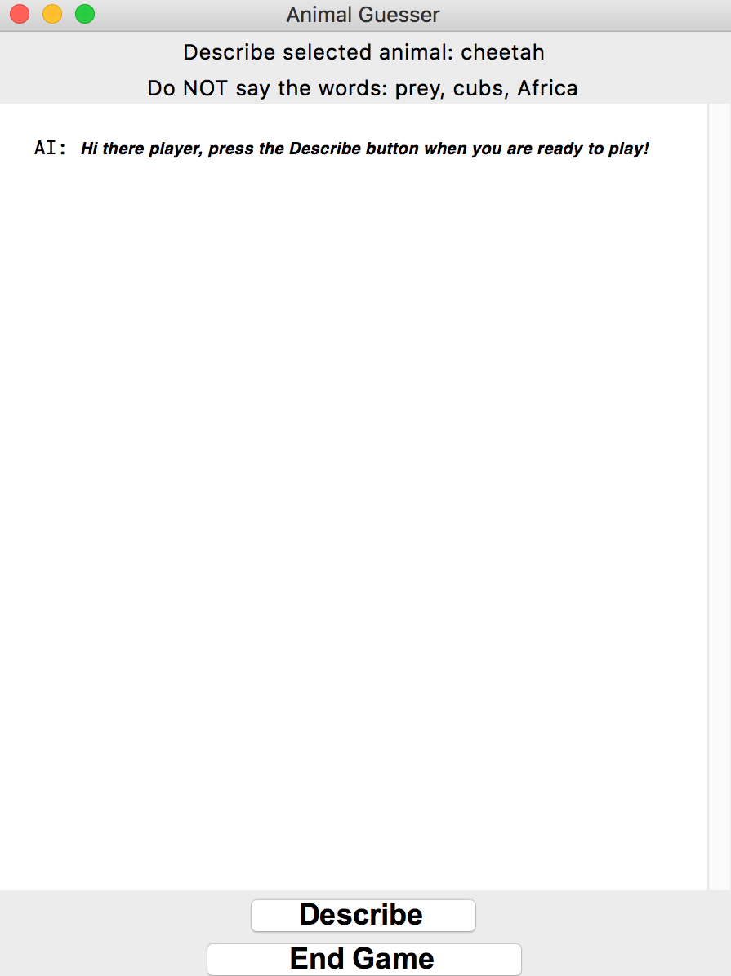
FRONT-END
Taboo Game-like
How to play?
3
User presses the DESCRIBE
button and starts describing
the animal without saying the
Taboo words

Slide 6
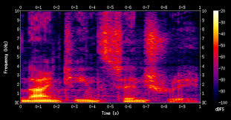
BRAIN ASPECT 1
Speech Recognition
How does it work?
Input spectrogram spoken letter
(audio slice of 20-40ms)
Each letter influences
the likelihood of the next
RNN
Probability of being […]
Z
A
B
C

Slide 7





BRAIN ASPECT 1
Speech Recognition
Speech Recognition as a Service
No account
needed
Audio
streaming
Unlimited
API call
Free

Slide 8
BRAIN ASPECT 1
Speech Recognition
Using SpeechRecognition and PyAudio python libraries
Retrieve
raw data
Convert to
.WAV
Retrieve speech
to text
User speaks
SaaS API
PyAudio
SpeechRecognition
SpeechRecognition
WIT API

Slide 9
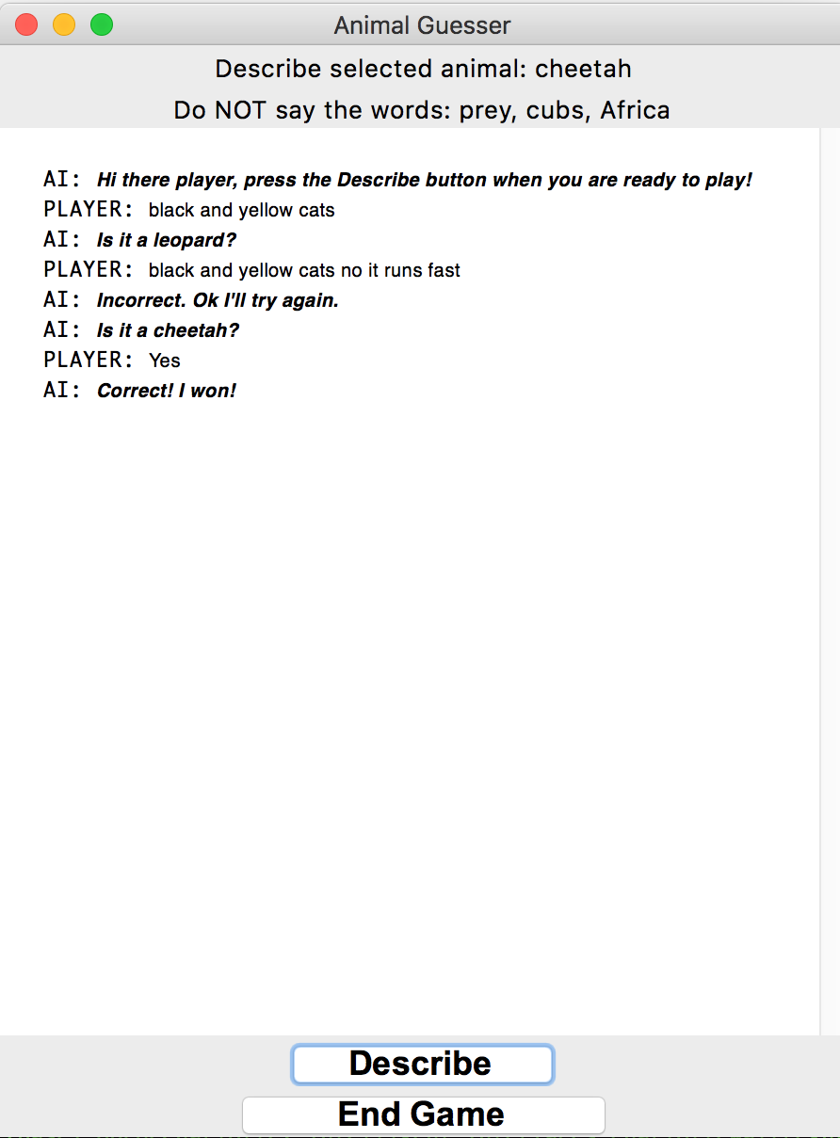
FRONT-END
Taboo Game-like
How to play?
4
The text is displayed
on the Chatbox and NLP
can be used to guess
the animal

Slide 10
BRAIN ASPECT 2
Natural Language Processing

Slide 11
BRAIN ASPECT 2
Natural Language Processing

Slide 12
BRAIN ASPECT 2
Natural Language Processing

Slide 13
FRONT-END
Taboo Game-like
How to play?
7
6
5
The game goes on until
the agent makes the correct
guess (the player says
yes), if 30s has passed or
if player says a taboo word
If agent is wrong, player
provides more info and
we go back to step 3
Agent makes its first guess

Slide 14
CHALLENGES
Issues faced

Slide 15
POSSIBLE IMPROVEMENTS

Slide 16
CONCLUSION

